Slide 1
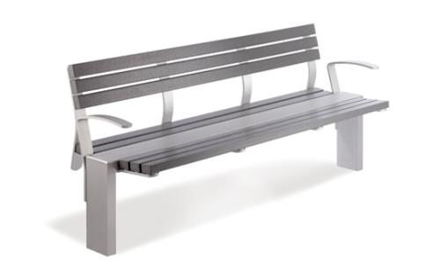
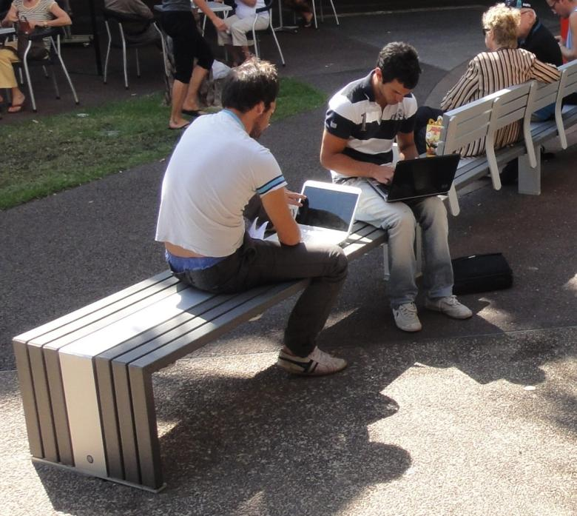
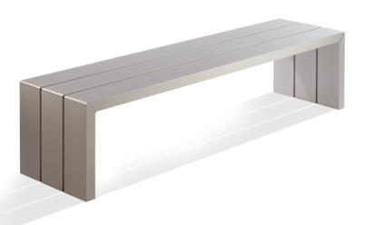
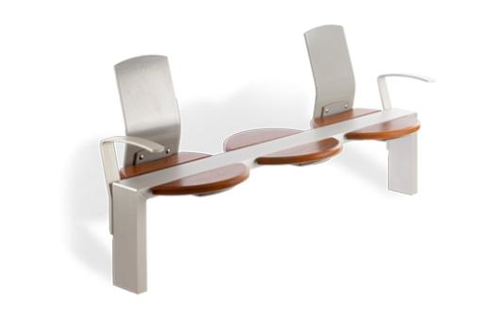
cox U R B A N F U R N I T U R E
Smith Street Mall - Darwin 2010
URBAN EDGE RANGE

Slide 2
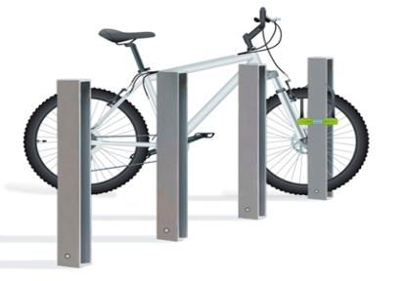
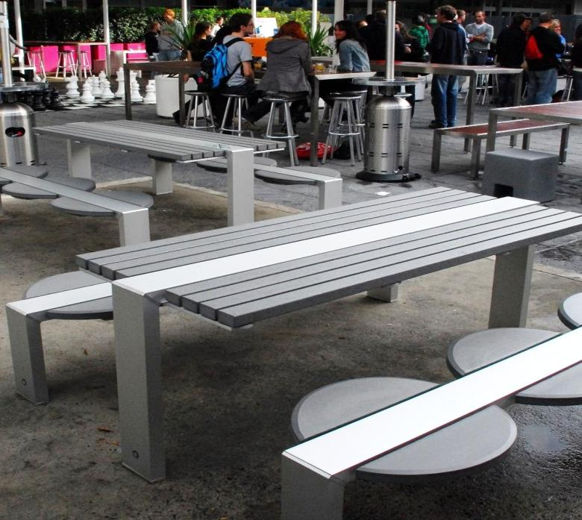
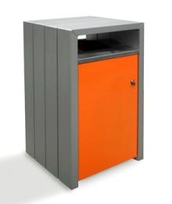
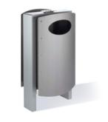
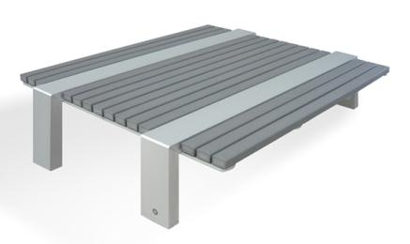
cox U R B A N F U R N I T U R E
University of NSW 2008
URBAN EDGE RANGE

Slide 3
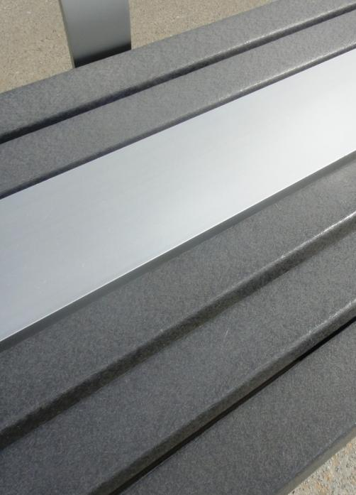
cox U R B A N F U R N I T U R E
no grain pattern on furniture battens
BATTENS - MATERIAL
Furnitureform™ Glass-Reinforced Recycled HDPE Plastic Imported direct from the USA
URBAN EDGE RANGE

Slide 4
cox U R B A N F U R N I T U R E
no grain pattern on furniture battens
BATTENS - MATERIAL
Furnitureform™ Glass-Reinforced Recycled HDPE Plastic
This material is NOT a wood/plastic composite!
URBAN EDGE RANGE

Slide 5
cox U R B A N F U R N I T U R E
no grain pattern on furniture battens
BATTENS - MATERIAL
Furnitureform™ Glass-Reinforced Recycled HDPE Plastic
This material is NOT a wood/plastic composite!
88% Recycled post consumer + post industrial High Density Polyethylene (HDPE)
URBAN EDGE RANGE

Slide 6
cox U R B A N F U R N I T U R E
no grain pattern on furniture battens
BATTENS - MATERIAL
Furnitureform™ Glass-Reinforced Recycled HDPE Plastic
This material is NOT a wood/plastic composite!
88% Recycled post consumer + post industrial High Density Polyethylene (HDPE)
7% Glass fibre for added strength + rigidity
URBAN EDGE RANGE

Slide 7
cox U R B A N F U R N I T U R E
no grain pattern on furniture battens
BATTENS - MATERIAL
Furnitureform™ Glass-Reinforced Recycled HDPE Plastic
This material is NOT a wood/plastic composite!
88% Recycled post consumer + post industrial High Density Polyethylene (HDPE)
7% Glass fibre for added strength + rigidity
4% Colourant with UV stabiliser (heavy metal free)
URBAN EDGE RANGE

Slide 8
cox U R B A N F U R N I T U R E
no grain pattern on furniture battens
BATTENS - MATERIAL
Furnitureform™ Glass-Reinforced Recycled HDPE Plastic
This material is NOT a wood/plastic composite!
88% Recycled post consumer + post industrial High Density Polyethylene (HDPE)
7% Glass fibre for added strength + rigidity
4% Colourant with UV stabiliser (heavy metal free)
1% Liquid blowing agent
URBAN EDGE RANGE

Slide 9
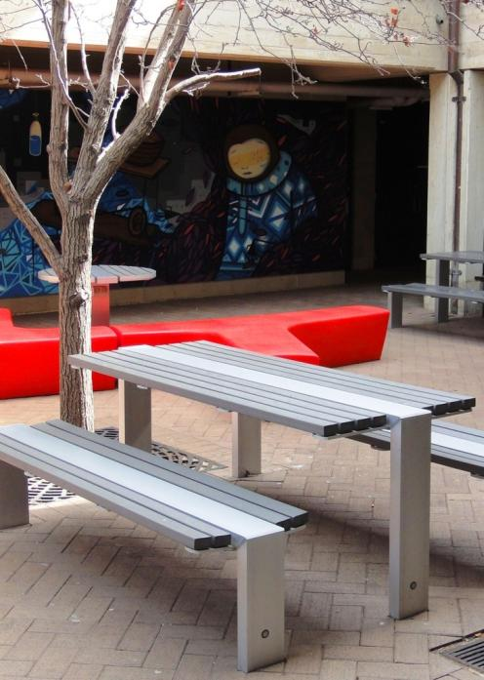
cox U R B A N F U R N I T U R E
Murdoch University - WA
BATTENS - FEATURES
Superior to wood composites no organic materials that can absorb moisture,
chemicals and dirt.
URBAN EDGE RANGE

Slide 10
cox U R B A N F U R N I T U R E
Murdoch University - WA
BATTENS - FEATURES
Superior to wood composites
Genuinely low maintenance solid-core inorganic plastic means no need to
waterproof, repaint or stain – EVER!
URBAN EDGE RANGE

Slide 11
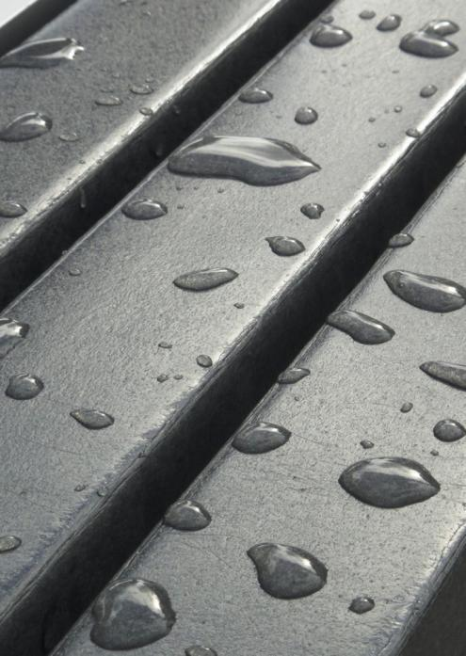
cox U R B A N F U R N I T U R E
BATTENS - FEATURES
Superior to wood composites
Genuinely low maintenance
Waterproof + fade resistant
naturally impervious to water, and UV stabilised
URBAN EDGE RANGE

Slide 12
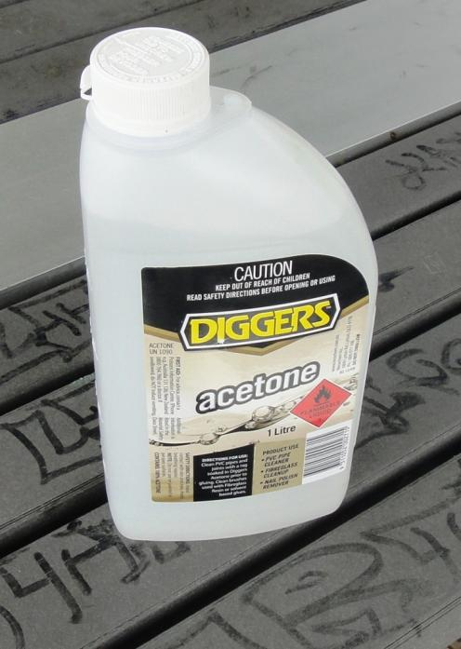
cox U R B A N F U R N I T U R E
BATTENS - FEATURES
Superior to wood composites
Genuinely low maintenance
Waterproof + fade resistant
Chemical + termite resistant
Impervious to most chemicals, and no organic
material to attract termites
URBAN EDGE RANGE

Slide 13
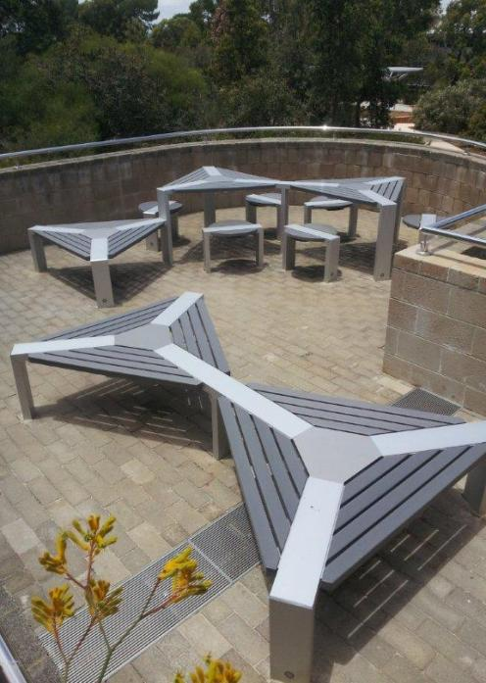
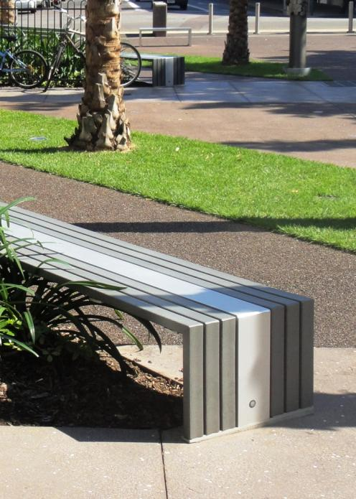
cox U R B A N F U R N I T U R E
Smith Street Mall - Darwin
BATTENS - FEATURES
Superior to wood composites
Genuinely low maintenance
Waterproof + fade resistant
Chemical + termite resistant
Strong and Durable
38mm thick + reinforced with glass fibre
Murdoch University - WA
URBAN EDGE RANGE

Slide 14
cox U R B A N F U R N I T U R E
Murdoch University - WA
BATTENS - FEATURES
Superior to wood composites
Genuinely low maintenance
Waterproof + fade resistant
Chemical + termite resistant
Strong and Durable
Attractive
a contemporary material with its own distinctive
appearance, colour and texture
URBAN EDGE RANGE

Slide 15
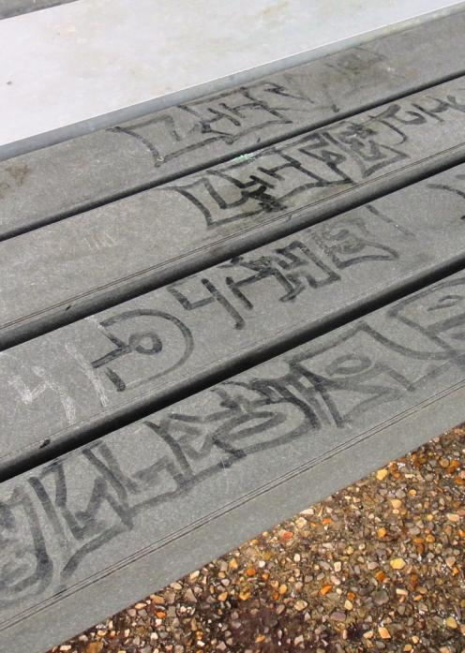
cox U R B A N F U R N I T U R E
Five year old table
BATTENS - FEATURES
Superior to wood composites
Genuinely low maintenance
Waterproof + fade resistant
Chemical + termite resistant
Strong and Durable
Attractive
Easy to remove grime and most graffiti
permanent marker, spray paint and scratches
URBAN EDGE RANGE

Slide 16
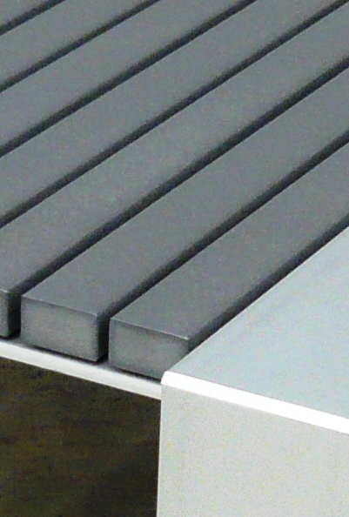
cox U R B A N F U R N I T U R E
BATTENS - COLOURS
Standard colour – ‘Charcoal Grey’
Large quantity held in stock in Perth
URBAN EDGE RANGE

Slide 17
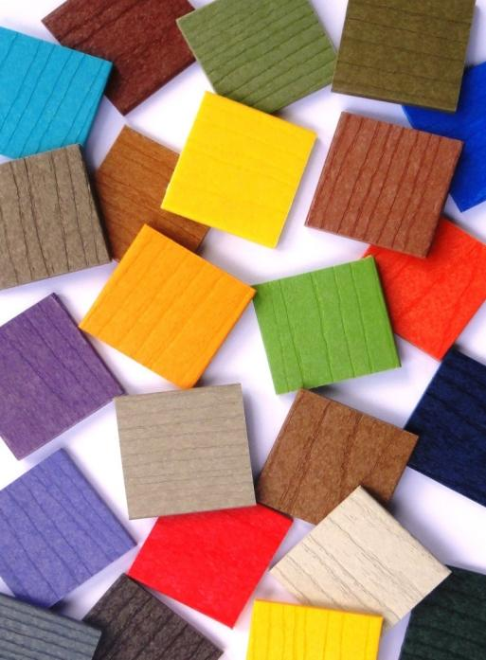
cox U R B A N F U R N I T U R E
No grain pattern on furniture battens
BATTENS - COLOURS
Standard colour – ‘Charcoal Grey’
Large quantity held in stock in Perth
Over 50 other colours available by ‘Special Order’
12 weeks delivery from USA
URBAN EDGE RANGE

Slide 18
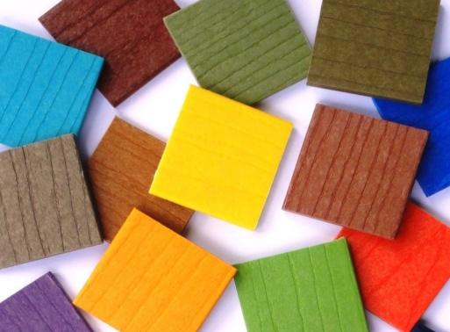
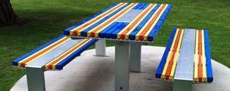
cox U R B A N F U R N I T U R E
Southport Broadwater - Gold Coast
BATTENS - COLOURS
Standard colour – ‘Charcoal Grey’
Large quantity held in stock in Perth
Over 50 other colours available by ‘Special Order’
12 weeks delivery from USA
Minimum shipment of 350 - 500 lineal metres for EACH ‘Special Order’ colour
No grain pattern on furniture battens
No grain pattern on furniture battens
URBAN EDGE RANGE

Slide 19
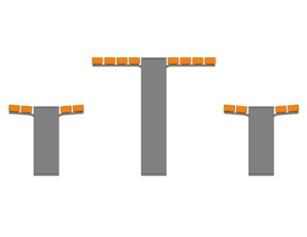
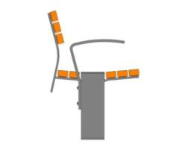
cox U R B A N F U R N I T U R E
No grain pattern on furniture battens
BATTENS - COLOURS
Examples - ‘Special Order’ colour minimum quantity
+
12 seats + 6 table settings = 350 lineal m
16 seats + 10 table settings = 500 lineal m
URBAN EDGE RANGE

Slide 20
cox U R B A N F U R N I T U R E
Five year old table
BATTENS - MAINTENANCE
It’s harsh out there! how often will maintenance be needed? how difficult will it be?
how long will it take? the true furniture cost is the initial purchase price + the accumulated maintenance costs
URBAN EDGE RANGE

Slide 21
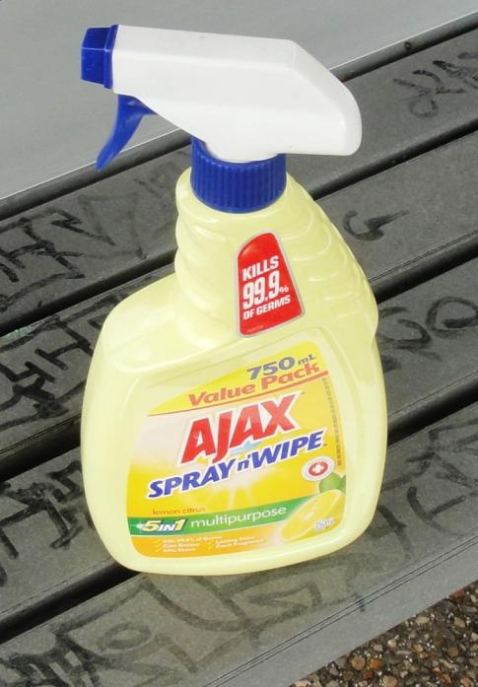
cox U R B A N F U R N I T U R E
Removal of stubborn grime
BATTENS - MAINTENANCE
No organic materials for grime to penetrate
let the rain wash it for you or spray n’ wipe if needed
URBAN EDGE RANGE

Slide 22
cox U R B A N F U R N I T U R E
Removal of markers and paint
BATTENS - MAINTENANCE
HDPE plastic unaffected by acetone means quick and easy removal of permanent marker ink without the need for sanding back
URBAN EDGE RANGE

Slide 23
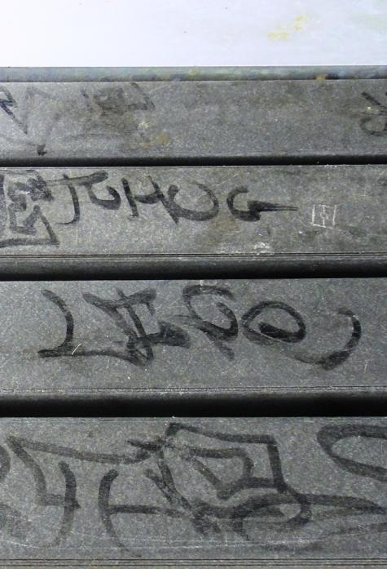
cox U R B A N F U R N I T U R E
Before
BATTENS - MAINTENANCE
Vandalised & grimy table battens before cleaning
URBAN EDGE RANGE

Slide 24
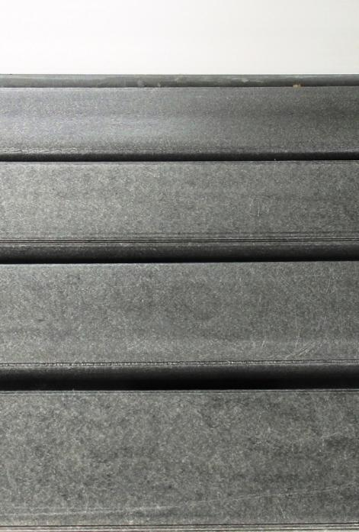
cox U R B A N F U R N I T U R E
After
BATTENS - MAINTENANCE
The same table after a few minutes cleaning
URBAN EDGE RANGE

Slide 25
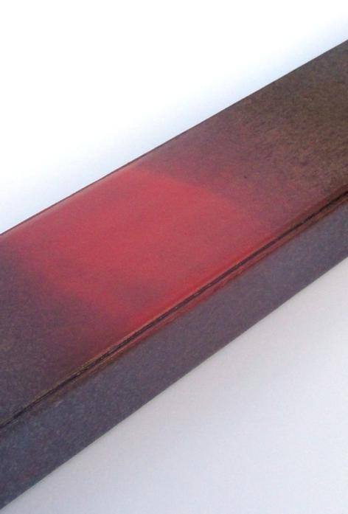
cox U R B A N F U R N I T U R E
Before
BATTENS - MAINTENANCE
No organic materials for paint to penetrate paint sits on the surface
URBAN EDGE RANGE

Slide 26
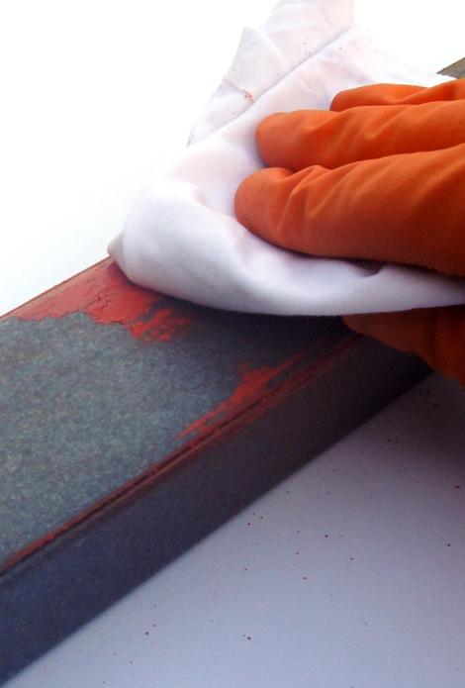
cox U R B A N F U R N I T U R E
Acetone
BATTENS - MAINTENANCE
Cured enamel spray paint removed with acetone
URBAN EDGE RANGE

Slide 27
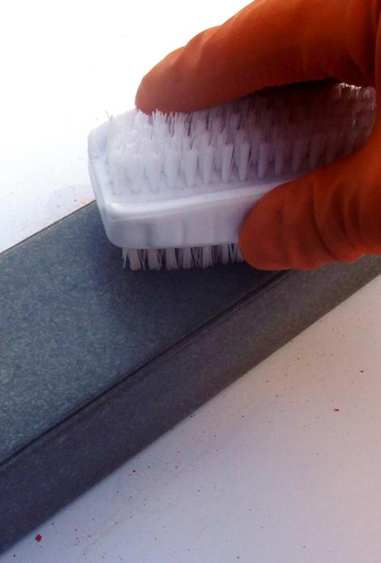
cox U R B A N F U R N I T U R E
Soft bristle brush
BATTENS - MAINTENANCE
Use a soft bristle brush if necessary
URBAN EDGE RANGE

Slide 28
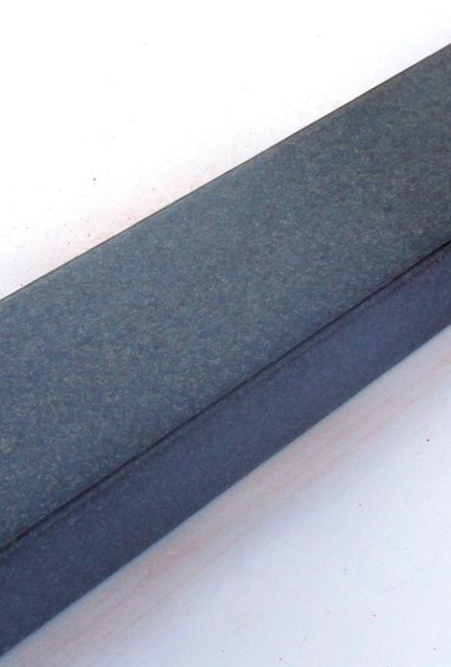
cox U R B A N F U R N I T U R E
After
BATTENS - MAINTENANCE
Batten fully restored preserving its original finish HDPE plastic is completely unaffected by the spray paint and the cleaning process.
URBAN EDGE RANGE

Slide 29
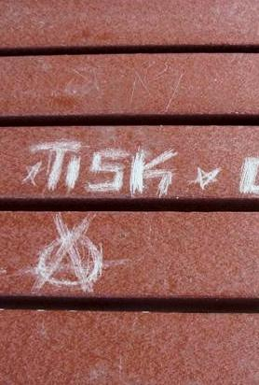
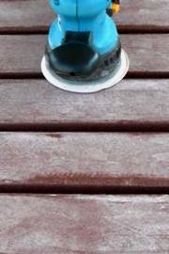
cox U R B A N F U R N I T U R E
Before
BATTENS - MAINTENANCE
Deeper scratches can also be removed on-site sand back to remove the scratches
Before
Sanding
URBAN EDGE RANGE

Slide 30
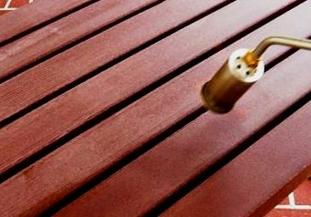
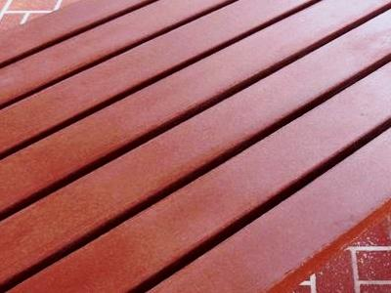
cox U R B A N F U R N I T U R E
Before
BATTENS - MAINTENANCE
Restore the original surface finish apply heat using a portable soft-flame burner
Heating
After
URBAN EDGE RANGE

Slide 31
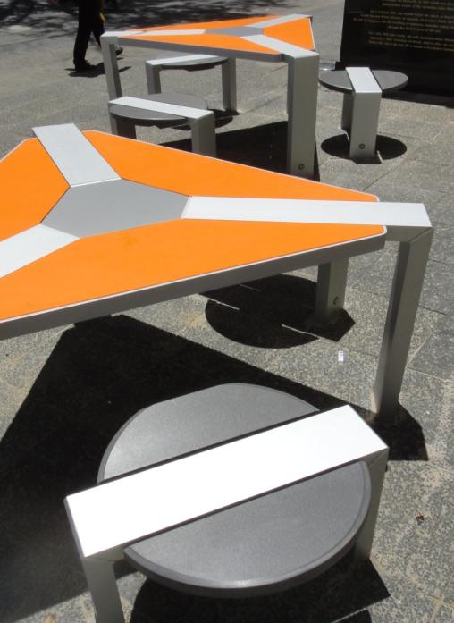
cox U R B A N F U R N I T U R E
no grain pattern on furniture battens
FRAMES - MATERIAL + FEATURES
Main frames on all furniture from 150 x 50 x 3mm aluminium RHS extrusion
URBAN EDGE RANGE

Slide 32
cox U R B A N F U R N I T U R E
no grain pattern on furniture battens
FRAMES - MATERIAL + FEATURES
Main frames on all furniture from 150 x 50 x 3mm aluminium RHS extrusion
Commercial grade 25 micron clear-anodised finish
URBAN EDGE RANGE

Slide 33
cox U R B A N F U R N I T U R E
no grain pattern on furniture battens
FRAMES - MATERIAL + FEATURES
Main frames on all furniture from 150 x 50 x 3mm aluminium RHS extrusion
Commercial grade 25 micron clear-anodised finish
Strong & durable + excellent resistance to corrosion
URBAN EDGE RANGE

Slide 34
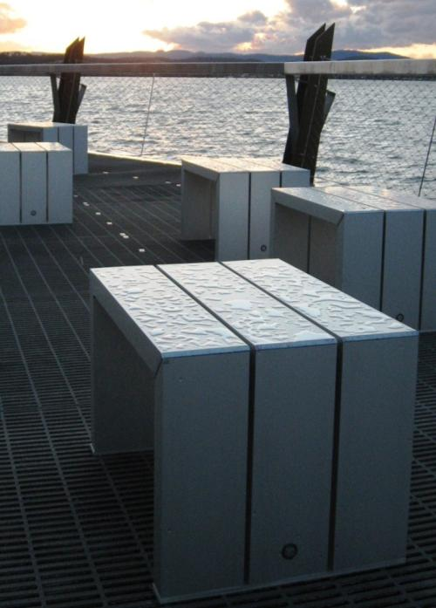
cox U R B A N F U R N I T U R E
no grain pattern on furniture battens
FRAMES - MATERIAL + FEATURES
Main frames on all furniture from 150 x 50 x 3mm aluminium RHS extrusion
Commercial grade 25 micron clear-anodised finish
Strong & durable + excellent resistance to corrosion
Custom cast aluminium corners connect vertical legs to horizontal beams tamperproof hidden fixing method
Lake Macquarie - NSW
URBAN EDGE RANGE

Slide 35
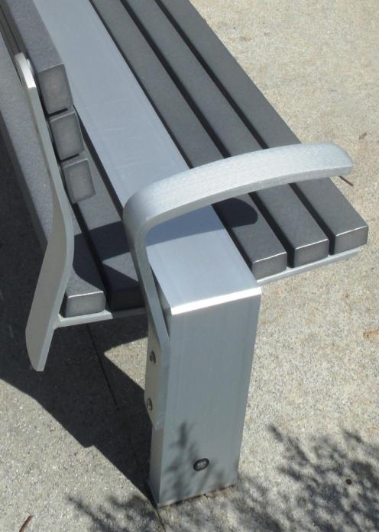
cox U R B A N F U R N I T U R E
FRAMES - MATERIAL + FEATURES
Main frames on all furniture from 150 x 50 x 3mm aluminium RHS extrusion
Commercial grade 25 micron clear-anodised finish
Strong & durable + excellent resistance to corrosion
Custom cast aluminium corners connect vertical legs to horizontal beams
Other components from aluminium flatbar tough 25 micron clear-anodised finish
South Perth Foreshore - WA
URBAN EDGE RANGE

Slide 36
cox U R B A N F U R N I T U R E
For further information email info@coxurbanfurniture.com.au
URBAN EDGE RANGE

